Slide 1

TRINITY INSTITUTE OF TECHNOLOGY AND RESEARCH
RAJIV GANDHI PROUDYOGIKI VISHWAVIDYALAYA, BHOPAL
New Scheme Based On AICTE Flexible Curricula
Computer Science and Engineering, VII-Semester
CS701 Software Architectures
BY –ABHILASHA SAXENA

Slide 2
Unit 4.
Software Architecture analysis and design: requirements for architecture and the life-cycle view of architecture design and analysis methods, architecture-based economic analysis: Cost Benefit Analysis Method (CBAM), Architecture Tradeoff Analysis Method (ATAM). Active Reviews for Intermediate Design (ARID), Attribute Driven Design method (ADD), architecture reuse, Domain –specific Software architecture.

Slide 3
Software Architecture analysis and design
The architecture of a system describes its major components, their relationships (structures), and how they interact with each other. Software architecture and design includes several contributory factors such as Business strategy, quality attributes, human dynamics, design, and IT environment.
We can segregate Software Architecture and Design into two distinct phases: Software Architecture and Software Design. In Architecture, nonfunctional decisions are cast and separated by the functional requirements. In Design, functional requirements are accomplished.

Slide 4
What is software architecture meaning?
Software architecture is, simply, the organization of a system. This organization includes all components, how they interact with each other, the environment in which they operate, and the principles used to design the software. In many cases, it can also include the evolution of the software into the future.

Slide 6
Software Architecture
Architecture serves as a blueprint for a system. It provides an abstraction to manage the system complexity and establish a communication and coordination mechanism among components.
It defines a structured solution to meet all the technical and operational requirements, while optimizing the common quality attributes like performance and security.
Further, it involves a set of significant decisions about the organization related to software development and each of these decisions can have a considerable impact on quality, maintainability, performance, and the overall success of the final product.

Slide 7
These decisions comprise of −
Selection of structural elements and their interfaces by which the system is composed.
Behavior as specified in collaborations among those elements.
Composition of these structural and behavioral elements into large subsystem.
Architectural decisions align with business objectives.
Architectural styles guide the organization.

Slide 8
Software Design
Software design provides a design plan that describes the elements of a system, how they fit, and work together to fulfill the requirement of the system. The objectives of having a design plan are as follows −
To negotiate system requirements, and to set expectations with customers, marketing, and management personnel.
Act as a blueprint during the development process.
Guide the implementation tasks, including detailed design, coding, integration, and testing.

Slide 10
Architecture Requirements are Ilities
Ilities -Within systems engineering, quality attributes are realized non-functional requirements used to evaluate the performance of a system. These are sometimes named "ilities" after the suffix many of the words share. They are usually Architecturally Significant Requirements that require architects' attention.
The business analyst(s) will collect the functional and system requirements. The architecture has other requirements. It is the job of the software architect to find and talk to the right people about them -- the system "ilities."
An "ility" is a characteristic or quality of a system that applies across a set of functional or system requirements. So, performance is an "ility" because it is applied against some of the functional or system requirements. Anything that can be expressed in the form "for a set of functional or system requirements, the system must fulfill them this way (this fast, this reliable, etc.)" is an "ility."

Slide 11
Architecture-based economic analysis: Cost Benefit Analysis Method (CBAM
Cost-Benefit Analysis Method (CBAM) CBAM an architecture for analyzing the costs, benefits and schedule implications of architectural decisions. ... The CBAM can aid the stakeholders in choosing architectural strategies based on their return on investment (ROI) – the ratio of benefit to cost

Slide 13


Slide 14


Slide 15


Slide 16


Slide 17


Slide 18


Slide 19


Slide 20


Slide 21


Slide 22


Slide 23


Slide 24
What is cost benefit analysis in system analysis and design?
A cost benefit analysis (also known as a benefit cost analysis) is a process by which organizations can analyze decisions, systems or projects, or determine a value for intangibles. The model is built by identifying the benefits of an action as well as the associated costs, and subtracting the costs from benefits.

Slide 26


Slide 27
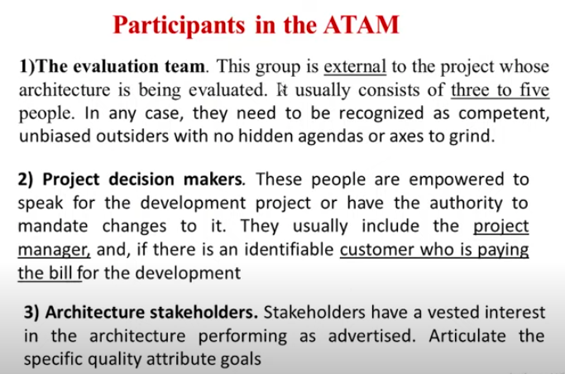

Slide 28
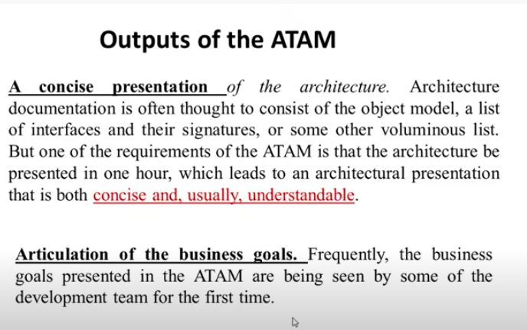

Slide 29
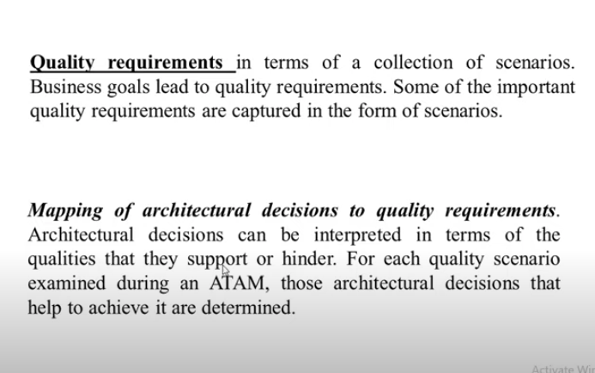

Slide 30
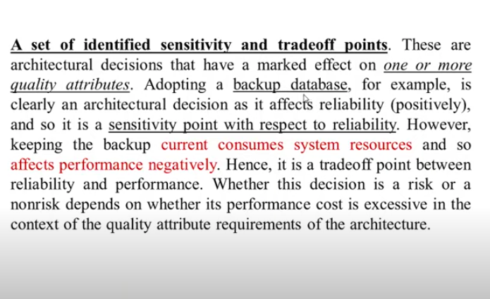

Slide 31
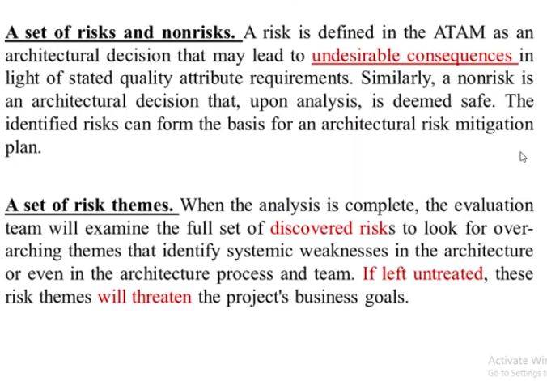

Slide 32
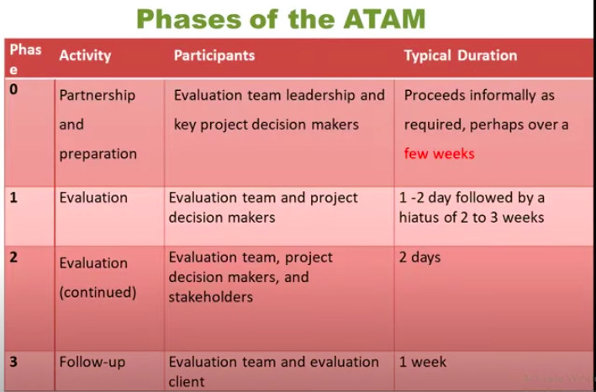

Slide 33
Active Reviews for Intermediate Design (ARID)
In software engineering, Active Reviews for Intermediate Designs (ARID) is a method to evaluate software architectures that combines aspects from architecture tradeoff analysis method (ATAM) and software architecture analysis method SAAM (Software architecture analysis method (SAAM) is a method used in software architecture to evaluate a system architecture. It was the first documented software architecture analysis method, and was developed in the mid 1990s to analyze a system for modifiability, but it is useful for testing any non-functional aspect) in a more tactical level.

Slide 35
ADD

Slide 36
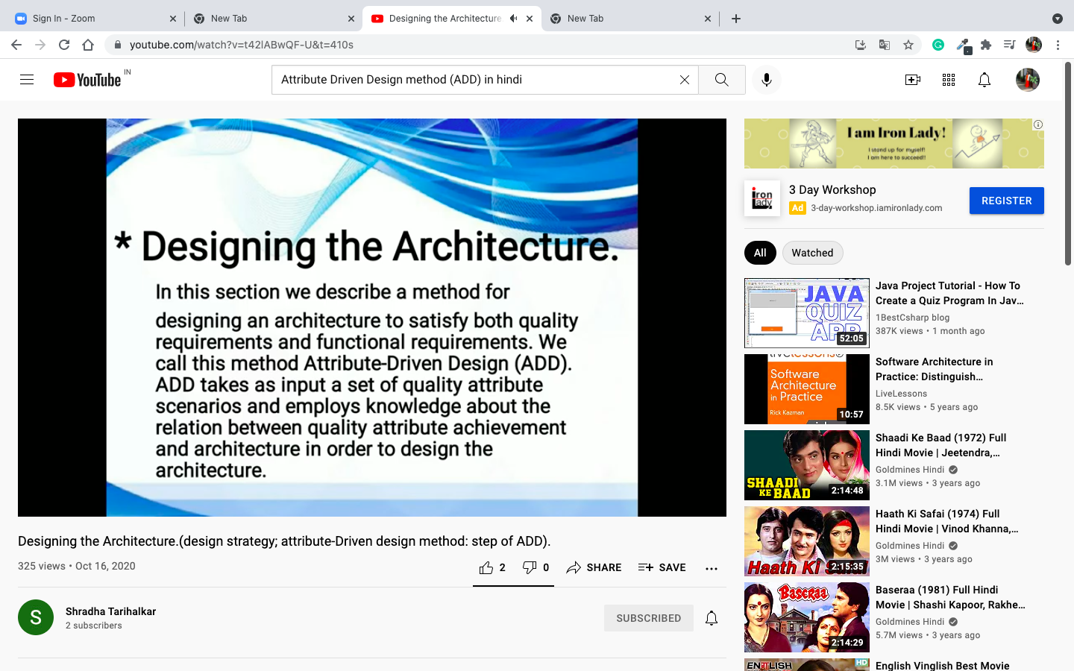

Slide 37
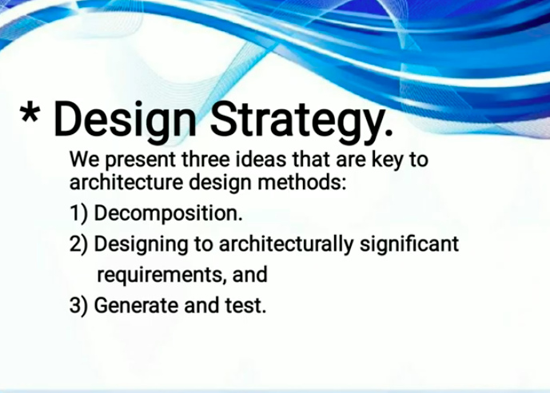

Slide 38
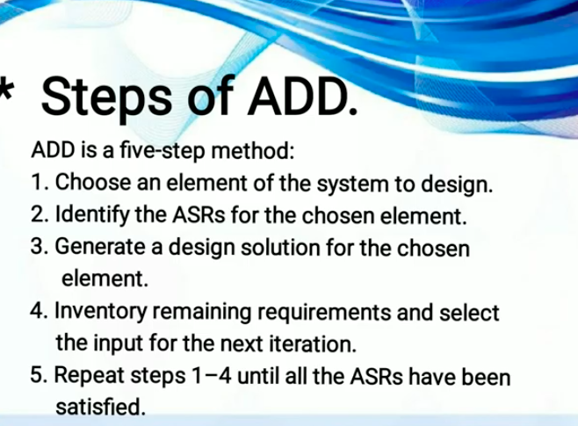

Slide 39
Attribute Driven Design method (ADD)
The SEI (Systems Engineering & Integration) Attribute-Driven Design (ADD) method is a systematic step-by-step method for designing the software architecture of a software-intensive system. It is an approach to defining software architectures by basing the design process on the architecture's quality attribute requirements.
Attribute-driven design is a methodology to create software architectures that takes into account the quality attributes of the software. It was previously known as the Architecture Based Design Method, but due to trademark issues the name was changed to Attribute-driven design around 2001

Slide 41
Architecture reuse
System reuse: Complete systems, which may include several application programs. ... Component reuse: Components of an application from sub-systems to single objects may be reused. Object and function reuse: Small-scale software components that implement a single well-defined object or function may be reused.
What is reuse software engineering?
Software reuse is the process of implementing or updating software systems using existing software assets. The systematic development of reusable components. The systematic reuse of these components as building blocks to create new system.

Slide 42
What is domain specific architecture?
A Domain-Specific Software Architecture (DSSA) is an assemblage of software components • specialized for a particular domain, • generalized for effective use across that domain, and • composed in a standardized structure (topology) effective for building successful applications.

